Slide 1

Final Report Plan
Week Commencing 21 March 2022

Slide 2
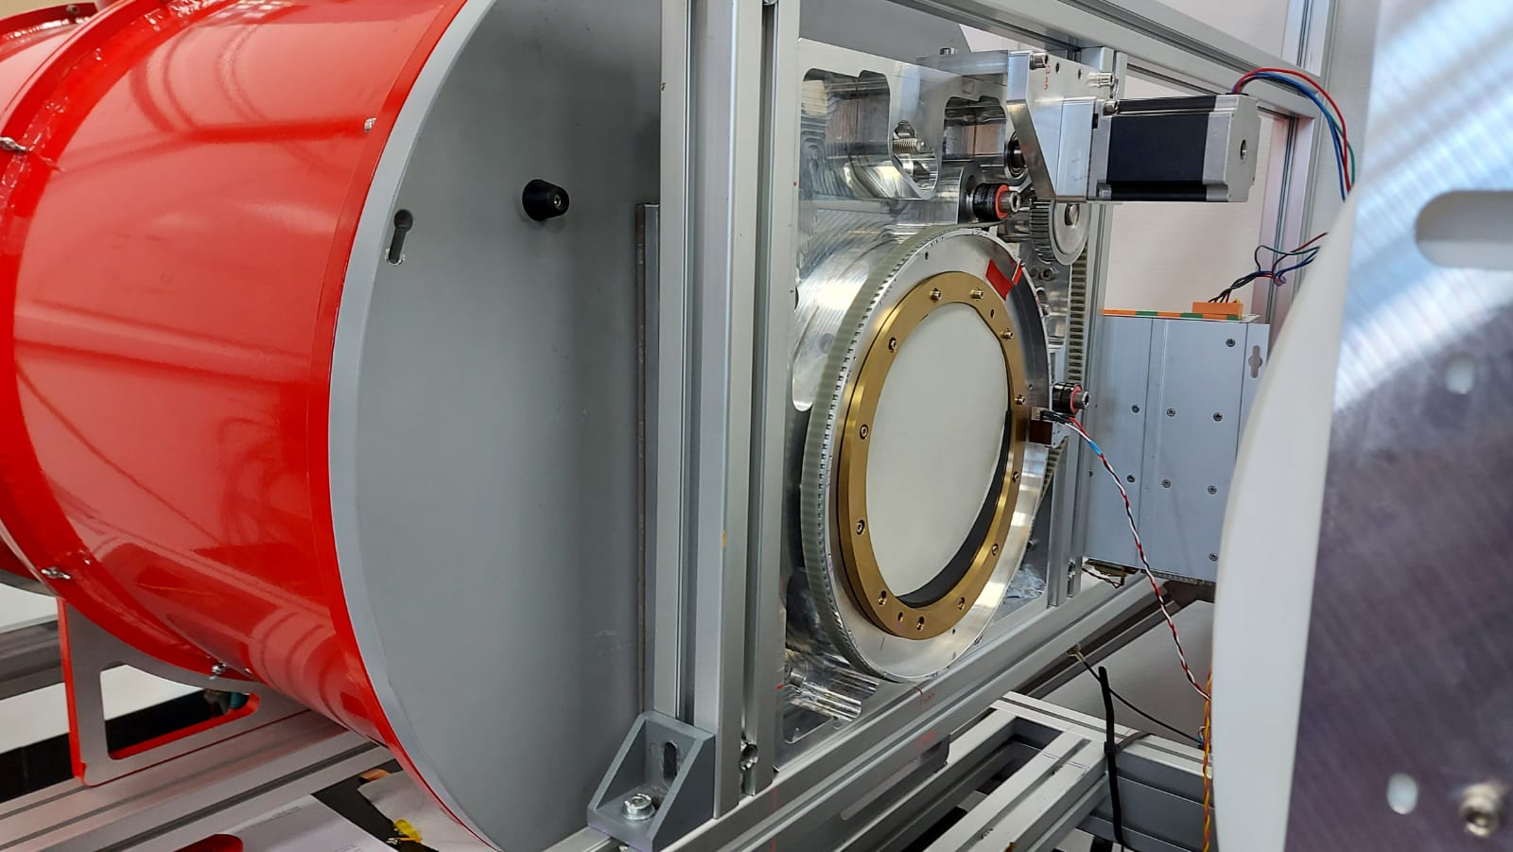
Characterizing Arrays of Kinetic Inductance Detectors
By Ashley Thean

Slide 3
Table of contents
Cover and Abstract and Acknowledgements (TBC)
Table of Contents
1. Introduction 1.1. Background 1.2. Kinetic Inductance Detectors 1.3. Characterizing Detector Systems 1.4 Aims and Objectives (Should I fit this in somewhere? Does not need its own section?)
2. Kinetic Inductance Detector Theory 2.1. Principles of Superconductivity 2.2. How Do KIDs Work? (Maybe better title?) 2.3. Ideal KID Simulation
(Refer Interim for this section)
3. Experimental 3.1 Detector Data 3.2 Modelling the Measured Power 3.3 Response of the Detector 3.4 Noise-Equivalent-Power
4. Results and Discussion 4.1 Noise Sources and Contributions 4.2 Analysis of the Results (Maybe better title?) 4.3 Implications to the System (Maybe better title?)
5. Conclusion
6. References
~1500 words each section
Conclusion + Abstract + Cover + table of contents + Reference ~1500 words
Total should be somewhere between 8000~8500 (9000 limit)

Slide 4
Introduction – Kinetic Inductance Detectors
Kinetic Inductance detector
Background

Slide 5
Introduction – Characterizing Detectors
How to characterize detectors?
Mention detector properties and how these are calculated (equations that will be referenced throughout report)
This is the aim of the project

Slide 6
Introductions – Aims and Objectives
Aims and objectives (Characterize an array of KIDs, ultimately yielding NEP distribution for all KIDs in an array)

Slide 7
Superconductivity
For now, rephrase the superconductivity stuff from interim and shorten
Subject to trimming as lack of words

Slide 9
Simulation of a KID using microwave electronics
Instead of separating them into separate topics, lump them into 1 section
Cut out majority of the derivation for all the equations and just quote them
IMPORTANT:
Describe the resonance curve and the different I and Q values (actual detector data)
Describe changes in temperature effects
Simulation parameters
dF0 formula

Slide 10
Experimental – Detector Data
Briefly describe how the detector takes data
Sweep data and timestream data
Detector Setup and what data is collected? (Hot bar and screen)
Use dF0 Formula and sweep data to convert I Q to dF0
Describe the observed shapes in graph (e.g reflection, varying scene, hotbar)

Slide 11
Experimental – Modelling the Measured Power
The room and hot bar can be modelled as a blackbody using planck to find intensity
Beam Filling Factor
Detector Filters & Transmission factor
Actual power room = intensity * Transmission factor * Throughput
Actual power hot bar = intensity * Transmission factor * Throughput * BeamFF
dP = hotbar power – room power
Maybe separate or merge some parts of the information here into different sections? (e.g. Power and Response of the detector & Factors affecting measured power)
Will reorganise when the section is written

Slide 12
Experimental – Response of Detector
Identify the hotbar
Able to model a Gaussian to the hotbar curve
Obtain peak height of the curve
Height/dT = Response in T
or Height/dP = Response in P

Slide 13
Experimental – Noise Equivalent Power
Obtain Fourier Transform of the noise signal (room measurement) for spectral density
Sqrt(spectral density)/Response = NEP
Repeat for other KIDs for a Histogram

Slide 14
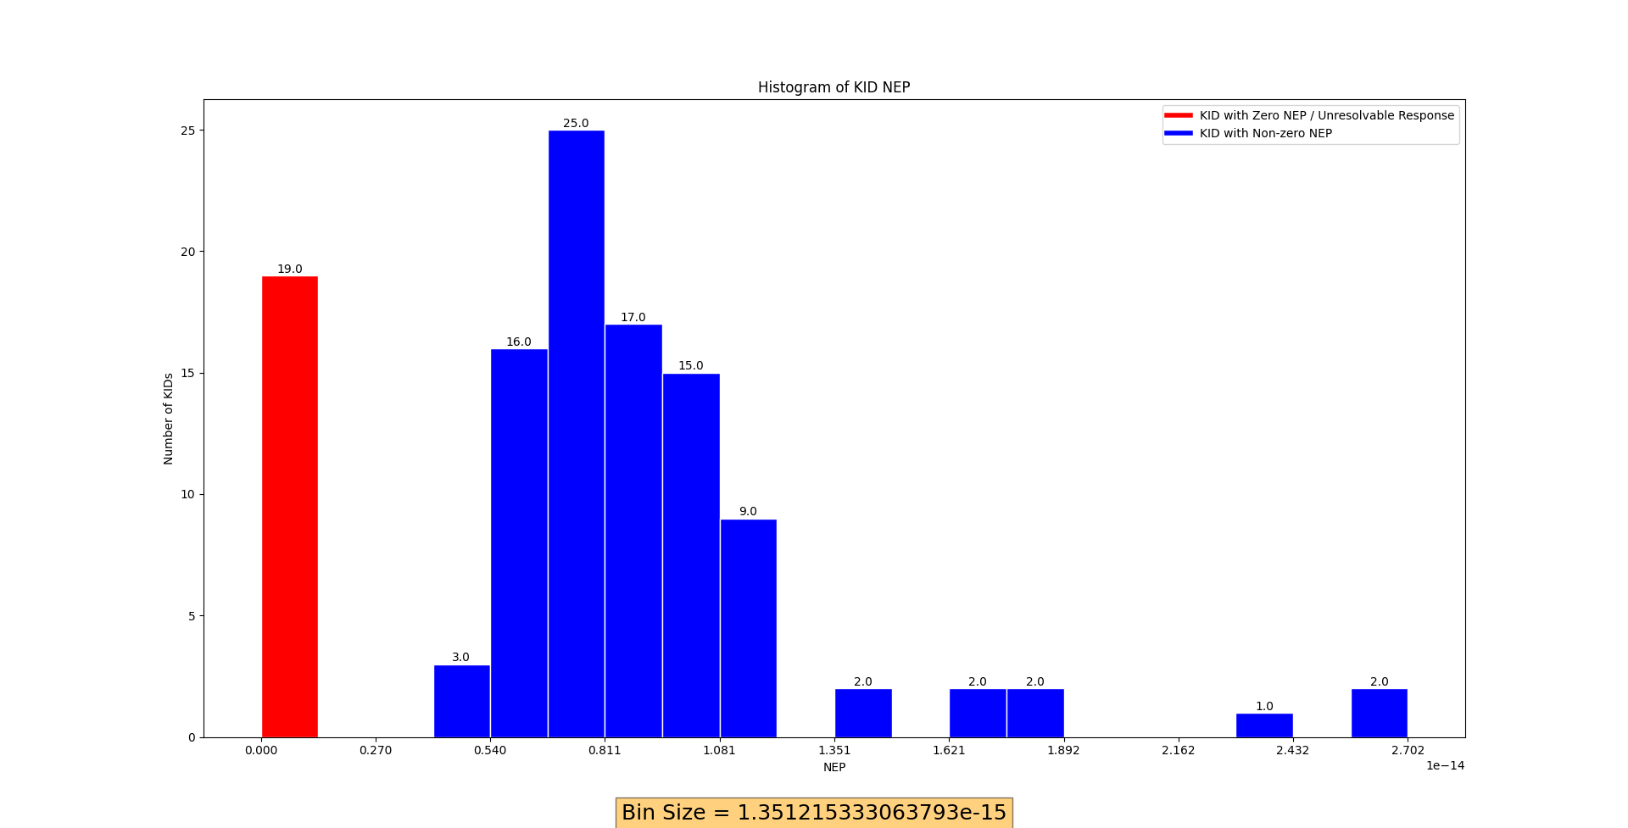

Slide 15
Results and Discussion – Noise Sources and Contributions
Give a brief description of the sources of noise (e.g.1/f, white noise, 59 Hz mains etc)
Describe fundamental limit of noise (Photon noise, wave + shot noise)
What causes the varying scene?
Why reflection?
KID temperature fluctuations (and how the dF0 formula tells us what range it deviates alot)

Slide 16
Results and Discussion – Analysis of Results
Compare obtained NEP against Photon noise
Does the values make sense?
Losses? (tbc):
Reflectivity, polypropylene

Slide 17
Results and Discussion – Implications to the System
Tying back to aims and objectives
Summarizing the information learnt and obtained throughout the project
What does the results tell us about the KID?
Area of improvements?
Contributions of
(This is a section that I am not so sure just yet. I want this section in the report to collect all the findings from the project and look back and reflect on areas of improvement, what this tells us about the KID, comparing the results with known values, etc.)

Slide 18
Conclusions and References

